Slide 1

Ions and molecules for ATAR chemistry

Slide 2
The goal – requirements for ATAR chemistry
ammonium | NH₄⁺ | magnesium | Mg²⁺ | hydrogencarbonate | HCO₃⁻ | sulfide | S²⁻
caesium | Cs⁺ | manganese (II) | Mn²⁺ | hydrogensulfate | H₂SO₄²⁻ | sulfite | SO₃²⁻
hydrogen | H⁺ | nickel (II) | Ni²⁺ | hydroxide | OH⁻ | nitride | N³⁻
lithium | Li⁺ | strontium | Sr²⁺ | iodide | I⁻ | phosphate | PO₄³⁻
potassium | K⁺ | zinc | Zn²⁺ | nitrate | NO₃⁻ | ammonia | NH₃
rubidium | Rb⁺ | aluminium | Al³⁺ | nitrite | NO₂⁻ | water | H₂O
silver | Ag⁺ | chromium (III) | Cr³⁺ | permanganate | MnO₄⁻ | hydrogen peroxide | H₂O₂
sodium | Na⁺ | iron (III) | Fe³⁺ | carbonate | CO₃²⁻ | ethanoic acid | CH₃COOH
barium | Ba²⁺ | bromide | Br⁻ | chromate | CrO₄²⁻ | hydrochloric acid | HCl
calcium | Ca²⁺ | chloride | Cl⁻ | dichromate | Cr₂O₇²⁻ | nitric acid | HNO₃
cobalt (II) | Co²⁺ | cyanide | CN⁻ | hydrogenphosphate | HPO₄²⁻ | carbonic acid | H₂CO₃
copper (II) | Cu²⁺ | dihydrogenphosphate | H₂PO₄⁻ | oxalate | C₂O₄²⁻ | sulfuric acid | H₂SO₄
iron (II) | Fe²⁺ | ethanoate (acetate) | CH₃COO⁻ | oxide | O²⁻ | sulfurous acid | H₂SO₃
lead (II) | Pb²⁺ | fluoride | F⁻ | sulfate | SO₄²⁻ | phosphoric acid | H₃PO₄

Slide 3
Strategies
Understand the periodic table
Transition metals all* +2
Use a mnemonic
From ‘-ate’s to ‘-ite’s
A little bit of brute force memorisation
Adding H+ to other ions

Slide 4
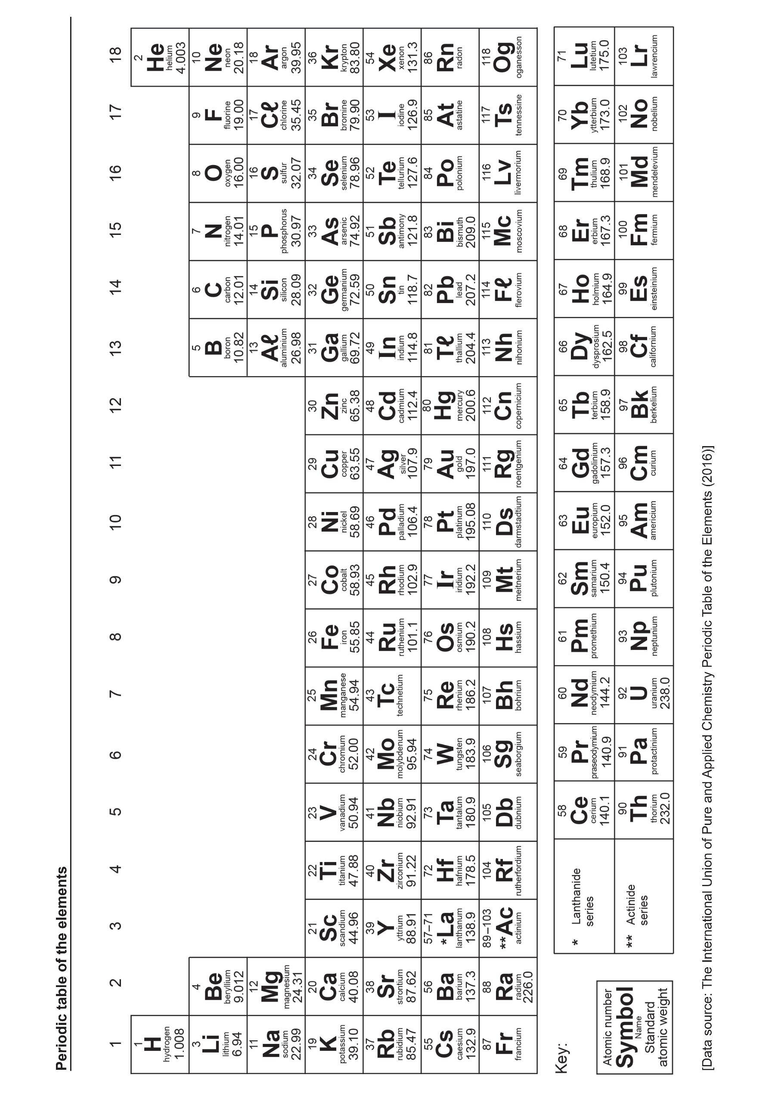
Understanding the periodic table
X⁺
X²⁺
X³⁺
X^{4+/4-}
X³⁻
X²⁻
X⁻
X
All +1 when ions
All +2 when ions
All +3 when ions
All -1 when ions
All +4/-4 when ions (it won’t come up)
All -3 when ions
All -2 when ions
Do not (normally) form ions

Slide 5
Naming these ions
These are the simplest monatomic (made of one atom) ions
Positive monatomic ions are just named after the element
So, Na⁺ is a sodium ion
Negative monatomic ions are named after the element but the ending is changed to ‘ide’
So, O²⁻ is an oxide ion

Slide 6
So what do we know now
ammonium | NH₄⁺ | magnesium | Mg²⁺ | hydrogencarbonate | HCO₃⁻ | sulfide | S²⁻
caesium | Cs⁺ | manganese (II) | Mn²⁺ | hydrogensulfate | H₂SO₄²⁻ | sulfite | SO₃²⁻
hydrogen | H⁺ | nickel (II) | Ni²⁺ | hydroxide | OH⁻ | nitride | N³⁻
lithium | Li⁺ | strontium | Sr²⁺ | iodide | I⁻ | phosphate | PO₄³⁻
potassium | K⁺ | zinc | Zn²⁺ | nitrate | NO₃⁻ | ammonia | NH₃
rubidium | Rb⁺ | aluminium | Al³⁺ | nitrite | NO₂⁻ | water | H₂O
silver | Ag⁺ | chromium (III) | Cr³⁺ | permanganate | MnO₄⁻ | hydrogen peroxide | H₂O₂
sodium | Na⁺ | iron (III) | Fe³⁺ | carbonate | CO₃²⁻ | ethanoic acid | CH₃COOH
barium | Ba²⁺ | bromide | Br⁻ | chromate | CrO₄²⁻ | hydrochloric acid | HCl
calcium | Ca²⁺ | chloride | Cl⁻ | dichromate | Cr₂O₇²⁻ | nitric acid | HNO₃
cobalt (II) | Co²⁺ | cyanide | CN⁻ | hydrogenphosphate | HPO₄²⁻ | carbonic acid | H₂CO₃
copper (II) | Cu²⁺ | dihydrogenphosphate | H₂PO₄⁻ | oxalate | C₂O₄²⁻ | sulfuric acid | H₂SO₄
iron (II) | Fe²⁺ | ethanoate (acetate) | CH₃COO⁻ | oxide | O²⁻ | sulfurous acid | H₂SO₃
lead (II) | Pb²⁺ | fluoride | F⁻ | sulfate | SO₄²⁻ | phosphoric acid | H₃PO₄

Slide 7
Transition metals all* +2
The remaining monatomic ions are all positive and are all from the middle of the periodic table – the transition metals
They are mostly +2 except for Ag⁺, Cr³⁺ and Fe which can be Fe²⁺ but can also be Fe³⁺

Slide 8
Naming transition metal ions
Transition metal ions are named after the element but get a number in roman numerals after their name which is their charge
So, Fe²⁺ is an iron (II) ion, while Fe³⁺ is an iron (III) ion
Ag⁺ and Zn²⁺ are exceptions, they don’t get the number, so they are just a silver ion, and a zinc ion

Slide 9
So what do we know now
ammonium | NH₄⁺ | magnesium | Mg²⁺ | hydrogencarbonate | HCO₃⁻ | sulfide | S²⁻
caesium | Cs⁺ | manganese (II) | Mn²⁺ | hydrogensulfate | H₂SO₄²⁻ | sulfite | SO₃²⁻
hydrogen | H⁺ | nickel (II) | Ni²⁺ | hydroxide | OH⁻ | nitride | N³⁻
lithium | Li⁺ | strontium | Sr²⁺ | iodide | I⁻ | phosphate | PO₄³⁻
potassium | K⁺ | zinc | Zn²⁺ | nitrate | NO₃⁻ | ammonia | NH₃
rubidium | Rb⁺ | aluminium | Al³⁺ | nitrite | NO₂⁻ | water | H₂O
silver | Ag⁺ | chromium (III) | Cr³⁺ | permanganate | MnO₄⁻ | hydrogen peroxide | H₂O₂
sodium | Na⁺ | iron (III) | Fe³⁺ | carbonate | CO₃²⁻ | ethanoic acid | CH₃COOH
barium | Ba²⁺ | bromide | Br⁻ | chromate | CrO₄²⁻ | hydrochloric acid | HCl
calcium | Ca²⁺ | chloride | Cl⁻ | dichromate | Cr₂O₇²⁻ | nitric acid | HNO₃
cobalt (II) | Co²⁺ | cyanide | CN⁻ | hydrogenphosphate | HPO₄²⁻ | carbonic acid | H₂CO₃
copper (II) | Cu²⁺ | dihydrogenphosphate | H₂PO₄⁻ | oxalate | C₂O₄²⁻ | sulfuric acid | H₂SO₄
iron (II) | Fe²⁺ | ethanoate (acetate) | CH₃COO⁻ | oxide | O²⁻ | sulfurous acid | H₂SO₃
lead (II) | Pb²⁺ | fluoride | F⁻ | sulfate | SO₄²⁻ | phosphoric acid | H₃PO₄

Slide 10
Use a mnemonic – the ‘-ate’s
Some of the most difficult ions to remember are the polyatomic (made of multiple atoms) ions
They all contain an element with a number of oxygens
Starting with the ‘-ate’s: nitrate, carbonate, sulfate, phosphate, oxalate, permanganate, chromate, dichromate
We need a word for each ion, that reminds us of its first element, the number of oxygens and its charge e.g.
Nick the Camel ate Supper in Phoenix with Carlos the Manly Crossword Critic

Slide 11
Nick the Camel ate Supper in Phoenix with Carlos the Manly Crossword Critic
Each word tells us the first element with its first letter
Each word tells us the number of oxygens with the number of consonants
Each word tells us the charge with the number of vowels
Nick = NO₃⁻ Camel = CO₃²⁻ Supper = SO₄²⁻ Phoenix = PO₄³⁻
Carlos = C₂O₄²⁻ Manly = MnO₄⁻ Crossword = Cr₂O₇²⁻ Critic = CrO₄²⁻

Slide 12
Naming the ‘-ate’s
Some are easy, they start with the element but end in ‘-ate’
Nick = NO₃⁻ = Nitrate Camel = CO₃²⁻ = Carbonate Supper = SO₄²⁻ = Sulfate
Phoenix = PO₄³⁻ = Phosphate Critic = CrO₄²⁻ = Chromate
Others just need to be memorised
Carlos = C₂O₄²⁻ = oxalate Manly = MnO₄⁻ = permanganate Crossword = Cr₂O₇²⁻ = dichromate

Slide 13
So what do we know now
ammonium | NH₄⁺ | magnesium | Mg²⁺ | hydrogencarbonate | HCO₃⁻ | sulfide | S²⁻
caesium | Cs⁺ | manganese (II) | Mn²⁺ | hydrogensulfate | H₂SO₄²⁻ | sulfite | SO₃²⁻
hydrogen | H⁺ | nickel (II) | Ni²⁺ | hydroxide | OH⁻ | nitride | N³⁻
lithium | Li⁺ | strontium | Sr²⁺ | iodide | I⁻ | phosphate | PO₄³⁻
potassium | K⁺ | zinc | Zn²⁺ | nitrate | NO₃⁻ | ammonia | NH₃
rubidium | Rb⁺ | aluminium | Al³⁺ | nitrite | NO₂⁻ | water | H₂O
silver | Ag⁺ | chromium (III) | Cr³⁺ | permanganate | MnO₄⁻ | hydrogen peroxide | H₂O₂
sodium | Na⁺ | iron (III) | Fe³⁺ | carbonate | CO₃²⁻ | ethanoic acid | CH₃COOH
barium | Ba²⁺ | bromide | Br⁻ | chromate | CrO₄²⁻ | hydrochloric acid | HCl
calcium | Ca²⁺ | chloride | Cl⁻ | dichromate | Cr₂O₇²⁻ | nitric acid | HNO₃
cobalt (II) | Co²⁺ | cyanide | CN⁻ | hydrogenphosphate | HPO₄²⁻ | carbonic acid | H₂CO₃
copper (II) | Cu²⁺ | dihydrogenphosphate | H₂PO₄⁻ | oxalate | C₂O₄²⁻ | sulfuric acid | H₂SO₄
iron (II) | Fe²⁺ | ethanoate (acetate) | CH₃COO⁻ | oxide | O²⁻ | sulfurous acid | H₂SO₃
lead (II) | Pb²⁺ | fluoride | F⁻ | sulfate | SO₄²⁻ | phosphoric acid | H₃PO₄

Slide 14
From ‘-ate’s to ‘-ite’s
‘-ite’s are exactly the same as ‘-ate’s but with one less oxygen
So if you can remember that sulfate is SO₄²⁻, then sulfite must be SO₃²⁻
And if you can remember that nitrate is NO₃⁻, then nitrite must be NO₂⁻

Slide 15
So what do we know now
ammonium | NH₄⁺ | magnesium | Mg²⁺ | hydrogencarbonate | HCO₃⁻ | sulfide | S²⁻
caesium | Cs⁺ | manganese (II) | Mn²⁺ | hydrogensulfate | H₂SO₄²⁻ | sulfite | SO₃²⁻
hydrogen | H⁺ | nickel (II) | Ni²⁺ | hydroxide | OH⁻ | nitride | N³⁻
lithium | Li⁺ | strontium | Sr²⁺ | iodide | I⁻ | phosphate | PO₄³⁻
potassium | K⁺ | zinc | Zn²⁺ | nitrate | NO₃⁻ | ammonia | NH₃
rubidium | Rb⁺ | aluminium | Al³⁺ | nitrite | NO₂⁻ | water | H₂O
silver | Ag⁺ | chromium (III) | Cr³⁺ | permanganate | MnO₄⁻ | hydrogen peroxide | H₂O₂
sodium | Na⁺ | iron (III) | Fe³⁺ | carbonate | CO₃²⁻ | ethanoic acid | CH₃COOH
barium | Ba²⁺ | bromide | Br⁻ | chromate | CrO₄²⁻ | hydrochloric acid | HCl
calcium | Ca²⁺ | chloride | Cl⁻ | dichromate | Cr₂O₇²⁻ | nitric acid | HNO₃
cobalt (II) | Co²⁺ | cyanide | CN⁻ | hydrogenphosphate | HPO₄²⁻ | carbonic acid | H₂CO₃
copper (II) | Cu²⁺ | dihydrogenphosphate | H₂PO₄⁻ | oxalate | C₂O₄²⁻ | sulfuric acid | H₂SO₄
iron (II) | Fe²⁺ | ethanoate (acetate) | CH₃COO⁻ | oxide | O²⁻ | sulfurous acid | H₂SO₃
lead (II) | Pb²⁺ | fluoride | F⁻ | sulfate | SO₄²⁻ | phosphoric acid | H₃PO₄

Slide 16
A little bit of brute force memorisation
At this point there are a few things we need to just memorise:
Ions:
CH3COO⁻ - ethanoate (acetate)
CN⁻ - cyanide
Molecules:
H₂O – water
NH₃ – ammonia
H₂O₂ – hydrogen peroxide

Slide 17
So what do we know now
ammonium | NH₄⁺ | magnesium | Mg²⁺ | hydrogencarbonate | HCO₃⁻ | sulfide | S²⁻
caesium | Cs⁺ | manganese (II) | Mn²⁺ | hydrogensulfate | H₂SO₄²⁻ | sulfite | SO₃²⁻
hydrogen | H⁺ | nickel (II) | Ni²⁺ | hydroxide | OH⁻ | nitride | N³⁻
lithium | Li⁺ | strontium | Sr²⁺ | iodide | I⁻ | phosphate | PO₄³⁻
potassium | K⁺ | zinc | Zn²⁺ | nitrate | NO₃⁻ | ammonia | NH₃
rubidium | Rb⁺ | aluminium | Al³⁺ | nitrite | NO₂⁻ | water | H₂O
silver | Ag⁺ | chromium (III) | Cr³⁺ | permanganate | MnO₄⁻ | hydrogen peroxide | H₂O₂
sodium | Na⁺ | iron (III) | Fe³⁺ | carbonate | CO₃²⁻ | ethanoic acid | CH₃COOH
barium | Ba²⁺ | bromide | Br⁻ | chromate | CrO₄²⁻ | hydrochloric acid | HCl
calcium | Ca²⁺ | chloride | Cl⁻ | dichromate | Cr₂O₇²⁻ | nitric acid | HNO₃
cobalt (II) | Co²⁺ | cyanide | CN⁻ | hydrogenphosphate | HPO₄²⁻ | carbonic acid | H₂CO₃
copper (II) | Cu²⁺ | dihydrogenphosphate | H₂PO₄⁻ | oxalate | C₂O₄²⁻ | sulfuric acid | H₂SO₄
iron (II) | Fe²⁺ | ethanoate (acetate) | CH₃COO⁻ | oxide | O²⁻ | sulfurous acid | H₂SO₃
lead (II) | Pb²⁺ | fluoride | F⁻ | sulfate | SO₄²⁻ | phosphoric acid | H₃PO₄

Slide 18
Adding H⁺ to other species
The last step is to understand how H+ adds to other species
Note that ‘-ous’ acids have one less oxygen than ‘-ic’ acids
base species | add one H⁺ | add two H⁺ | add three H⁺
chloride Cl⁻ | hydrochloric acid HCl
nitrate NO₃⁻ | nitric acid HNO₃
oxide O²⁻ | hydroxide OH⁻ | water H₂O
carbonate CO₃²⁻ | hydrogencarbonate HCO₃⁻ | carbonic acid H₂CO₃
sulfate SO₄²⁻ | hydrogensulfate HSO₄⁻ | sulfuric acid H₂SO₄
sulfite SO₃²⁻ | hydrogensulfite HSO₃⁻ | sulfurous acid H₂SO₃
phosphate PO₄³⁻ | hydrogenphosphate HPO₄²⁻ | dihydrogenphosphate H₂PO₄⁻ | phosphoric acid H₃PO₄
ethanoate CH₃COO⁻ | ethanoic acid CH₃COOH
ammonia NH₃ | ammonium NH₄⁺

Slide 19
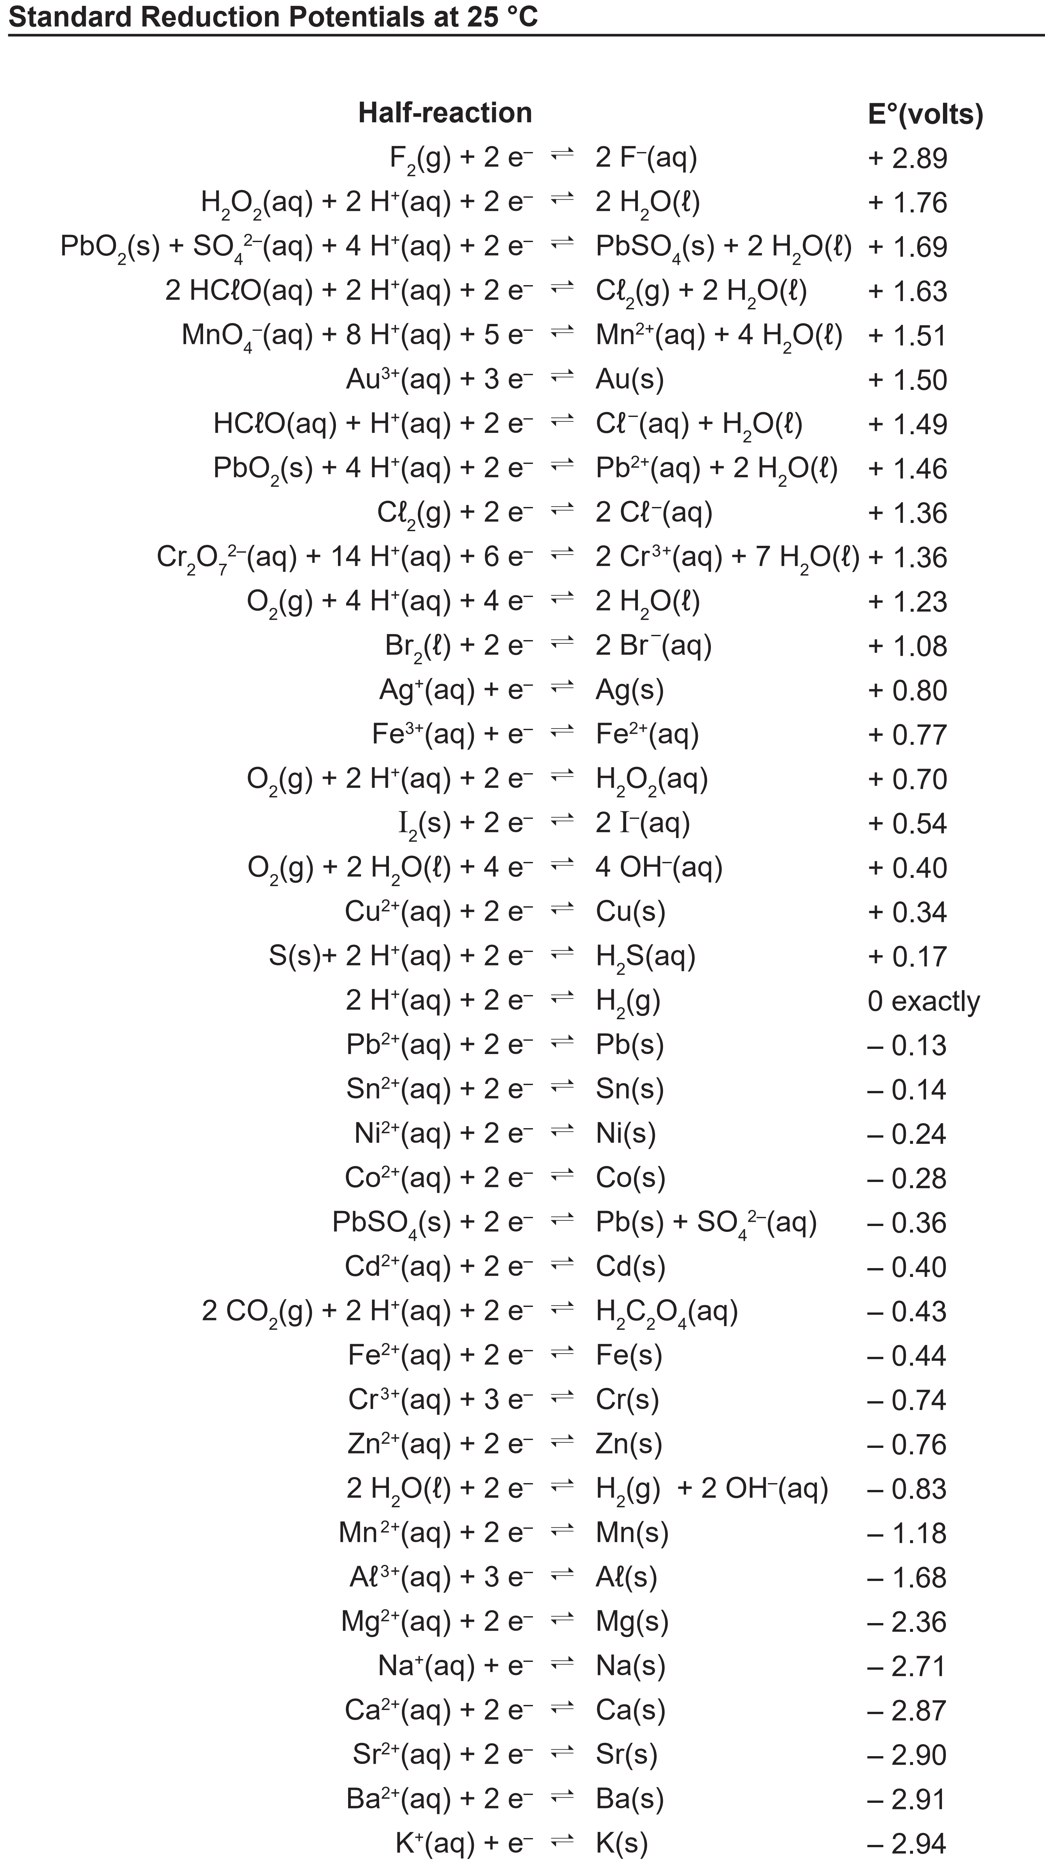
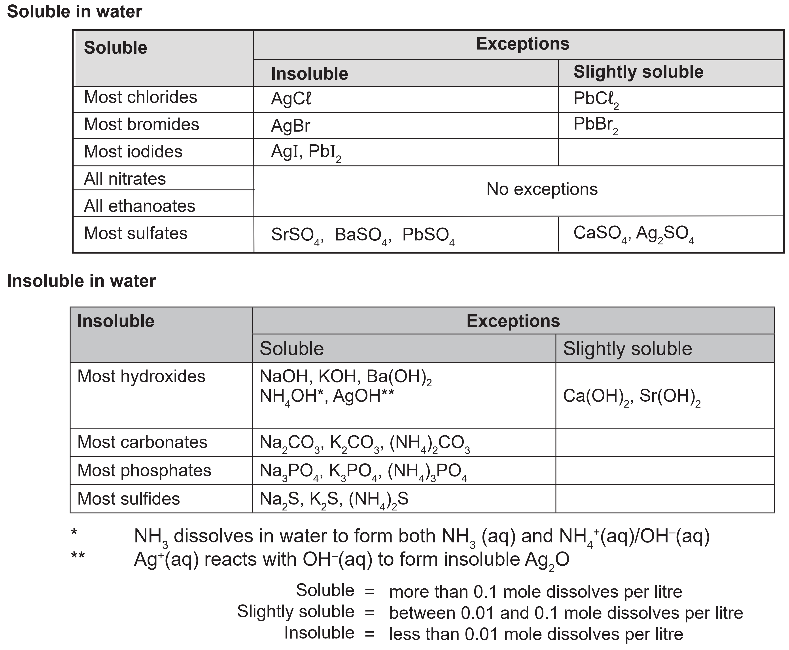
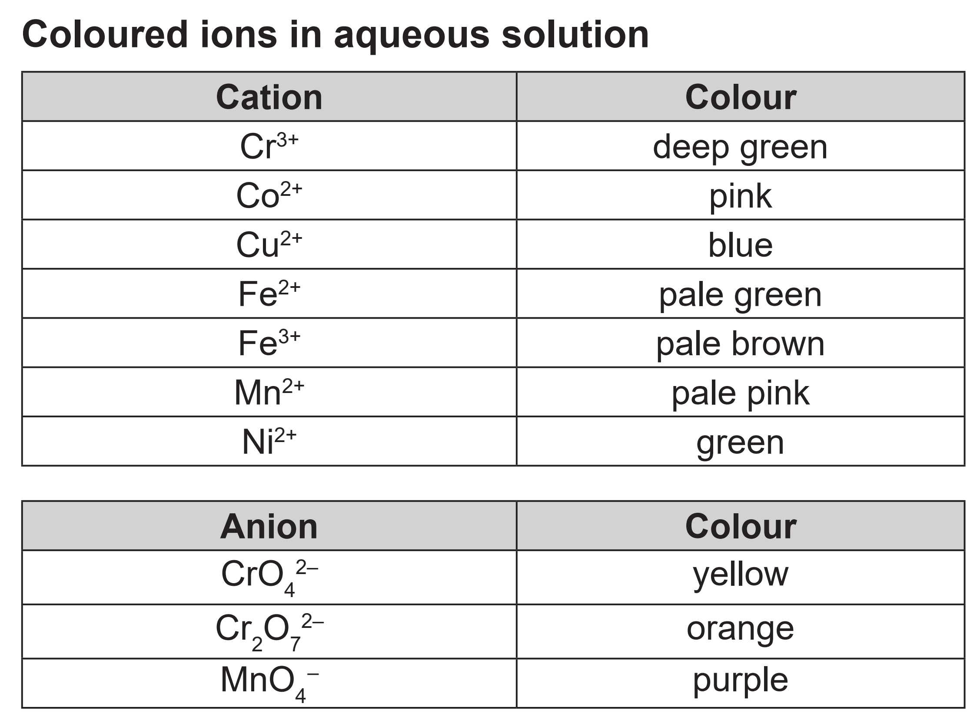
Backup
If you find yourself unsure in a test, many ions can be found on the datasheet in the solubility, colours and reduction potentials sections

